Slide 1
Setting up a calendar

Slide 2
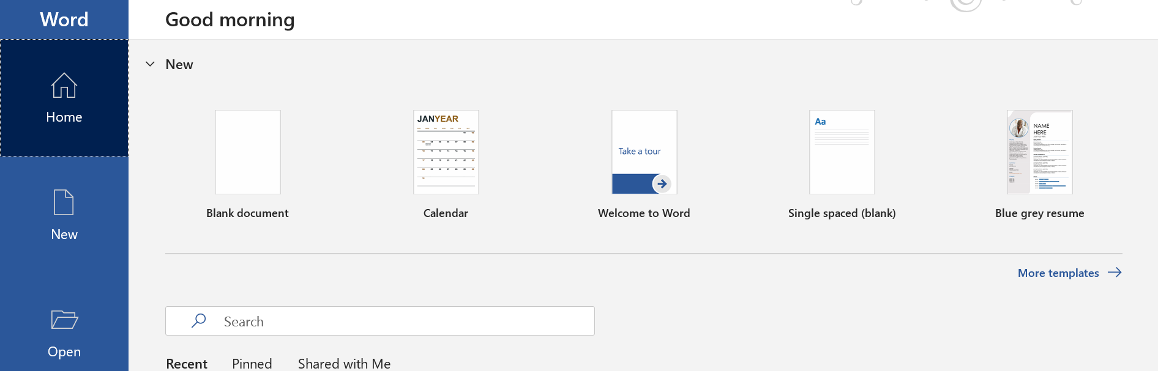
Word Calendar

Slide 3
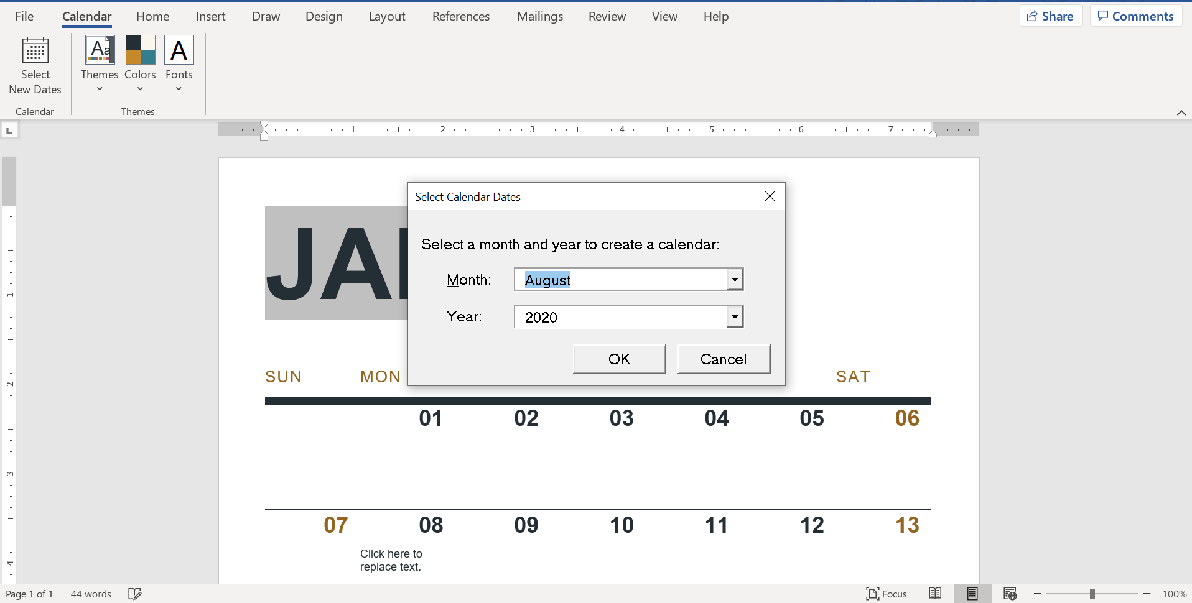

Slide 4
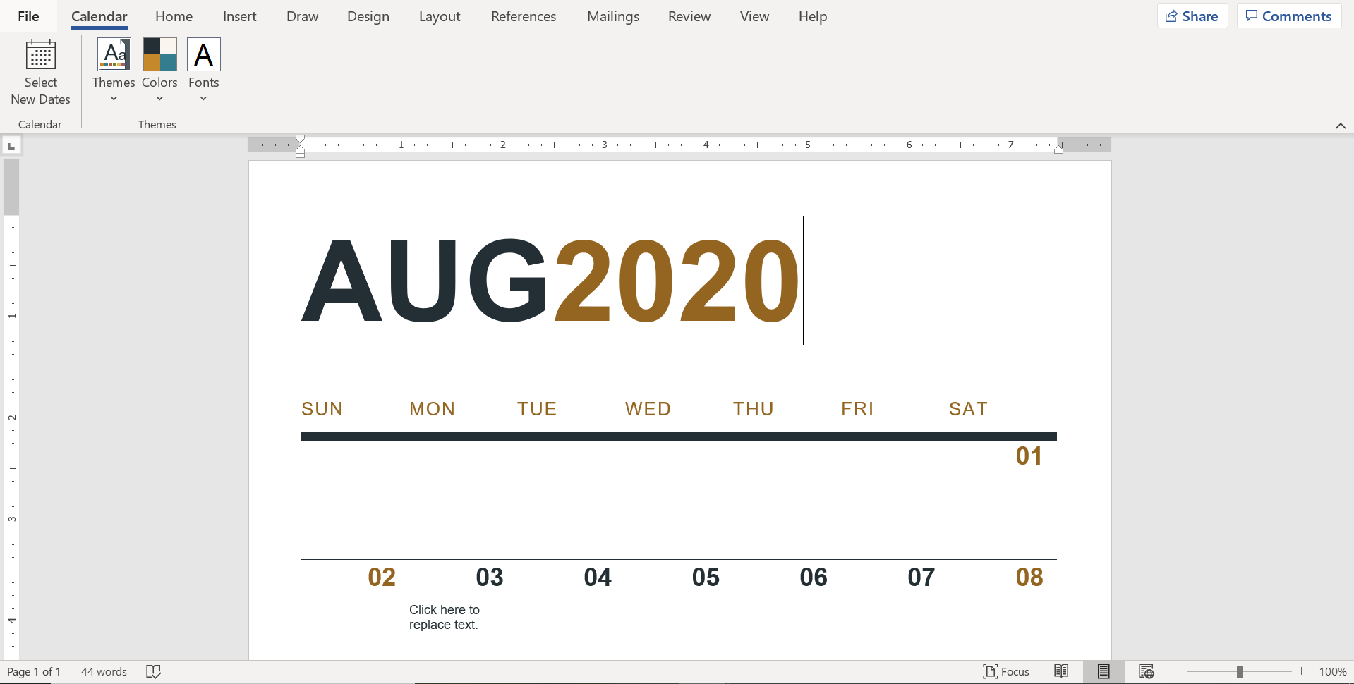
Use this to change the color scheme of your calendar

Slide 5
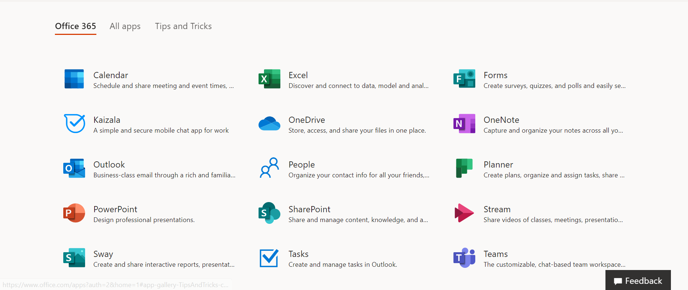
Office 365
Office 365 also has two great planning tools!

Slide 6
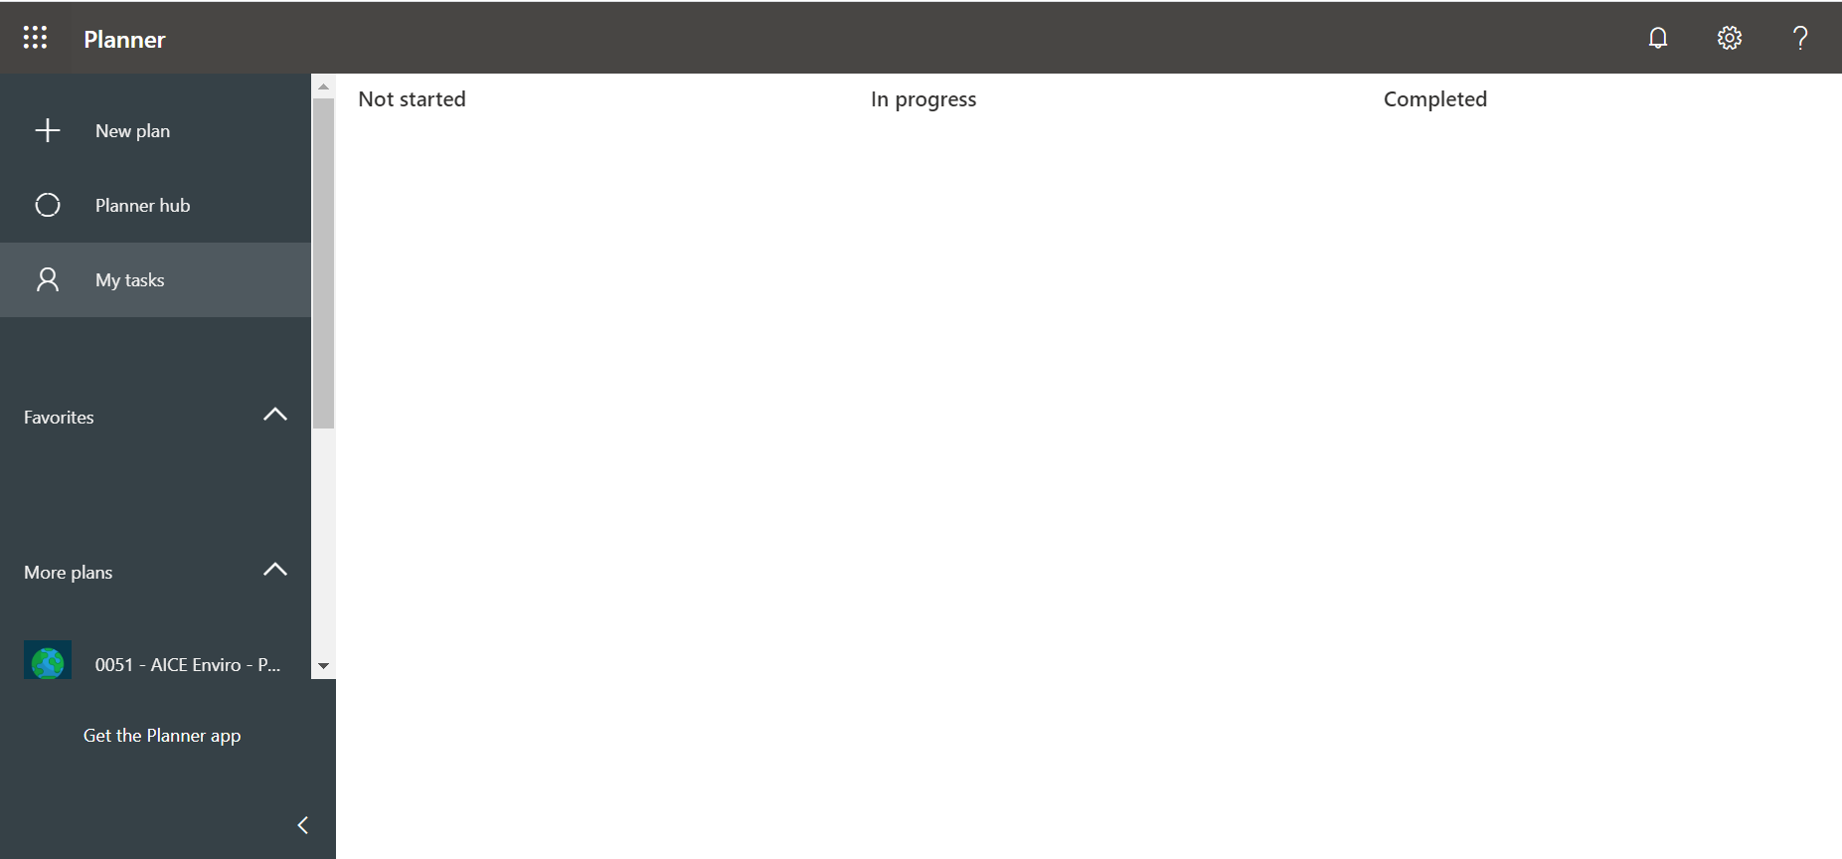
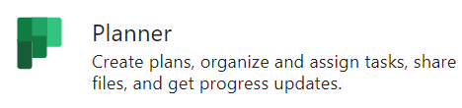
Planner is great because you can share it with other people. If you have a group project, this allows everyone to see the timeline

Slide 7

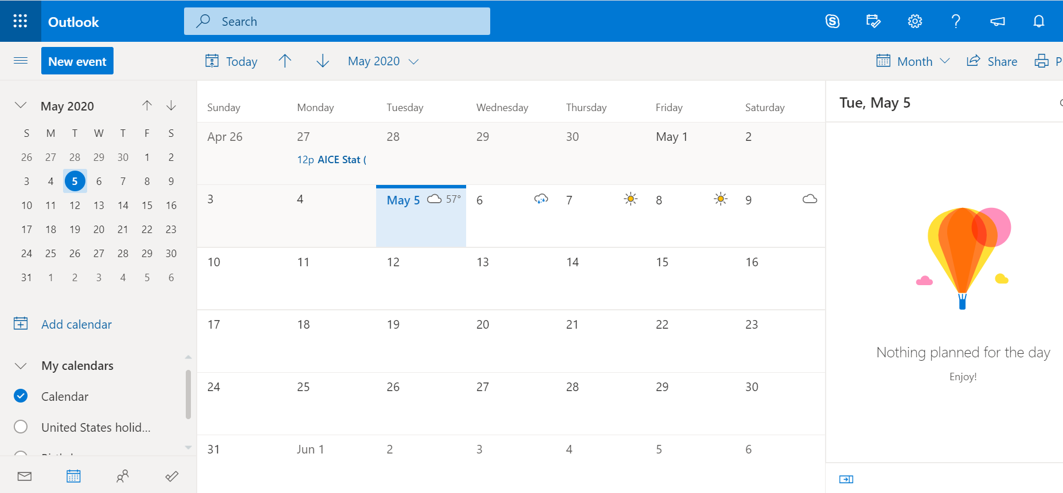
Calendar is a great way to organize due dates. It will also show assignments due through teams for other classes.

Slide 8
Extra Tips:
Color code by class: this doesn’t need to be complex it just helps to distinguish between assignments and due dates
Download the calendar or planner app on your phone. It will make you much more likely to check it
Plan no more than a month in advance. This will ensure if due dates change you will remember to update this.

